Slide 1
Multiple Regression Part 1 Using RStudio for Ag Data
STAT 441/541 Statistical Methods II

Slide 2
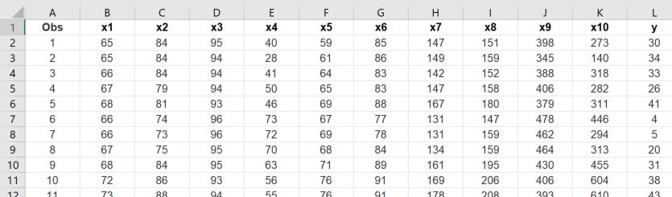
Ag Data Excel File
First row contains variable names. Recall that R is case sensitive.
Note that Column 1 is not an independent variable. It only identifies each observation.
This is a partial listing. There are n=46 observations in this data file.
Always look at the actual data file to verify it is a valid statistical dataset, with columns as variables and rows as observations. For example, column 7 is variable x6.

Slide 3
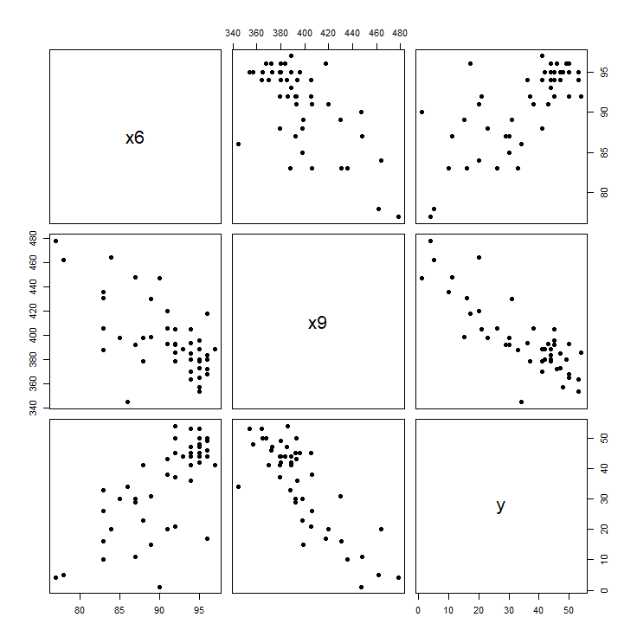
Scatterplot Matrix
For this row, x6 is on the vertical axis with variables x9 and y on the horizontal axes.
For this row, x9 is on the vertical axis with variables x6 and y on the horizontal axes.
For this row, y is on the vertical axis with independent variables x6 and x9 on the horizontal axes.
Shows relationship between dependent and independent variables.

Slide 4

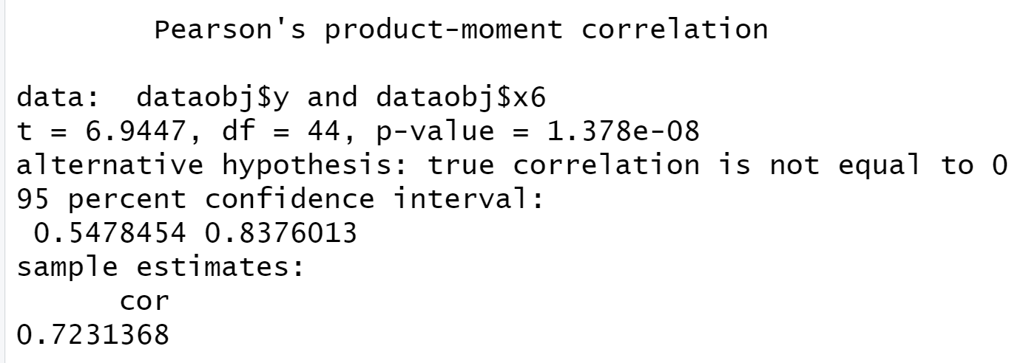
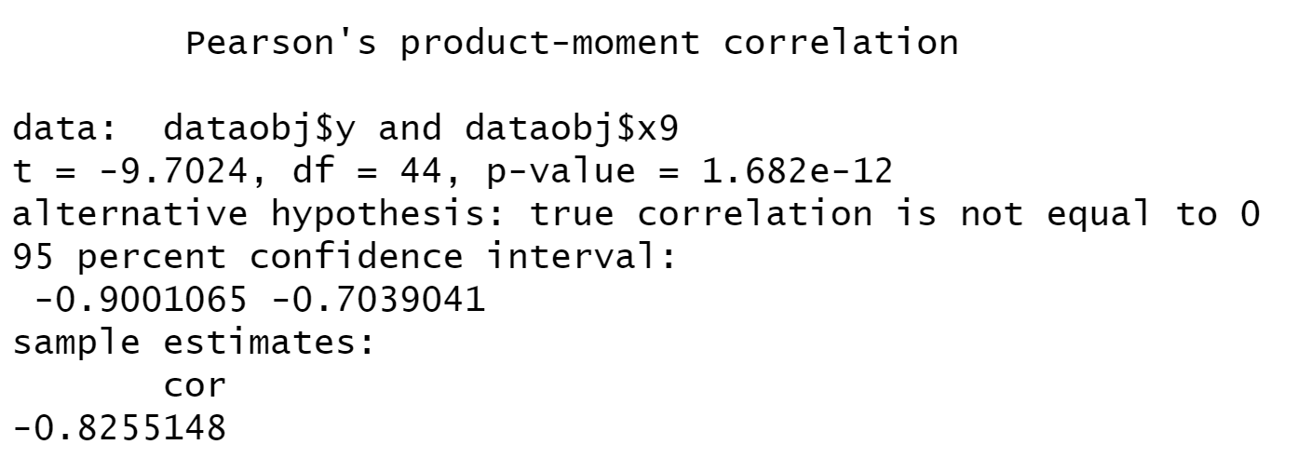
Correlation Coefficients
Examine correlation between dependent and each independent variable.
The sample correlation coefficient is 0.7231 so there is positive correlation between y and x6. The p-value is 0.00000001378, which is less than 0.05, so this is statistically significant at the 0.05 level. The scatterplot for y and x6 shows this is a linear relationship.
Test Statistic
p-value
Sample Correlation Coefficient
The sample correlation coefficient is -0.8255 so there is negative correlation between y and x9. The p-value is 0.000000000001682, which is less than 0.05, so this is statistically significant at the 0.05 level. The scatterplot for y and x9 shows this is a linear relationship.

Slide 5
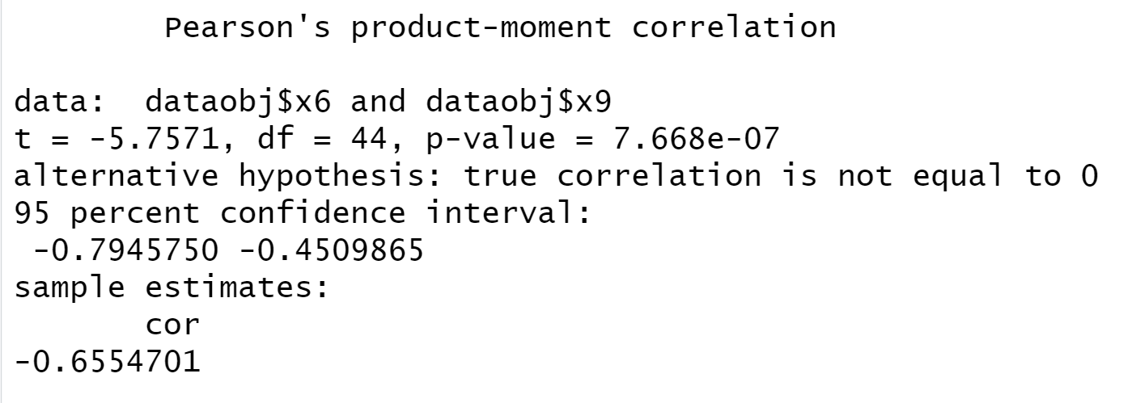
Correlation Coefficients (continued)
Examine correlation between each pair of independent variables. Since there are only two independent variables, there is only one pair which is x6 and x9.
Test Statistic
p-value
Sample Correlation Coefficient
The sample correlation coefficient is -0.6555 so there is negative correlation between x6 and x9. The p-value=0.0000007668, which is less than 0.05, so this is statistically significant at the 0.05 level. The scatterplot for x6 and x9 shows this is a linear relationship.

Slide 6
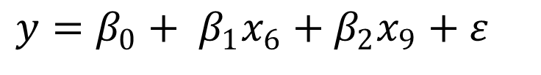
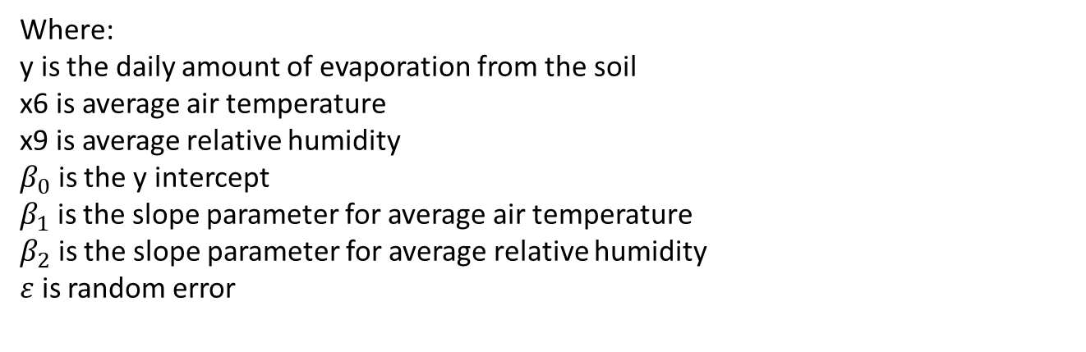
Multiple Regression Model
The proposed model is:
$$y=β_{0}+ β_{1}x_{6}+β_{2}x_{9}+ε$$
Where:
y is the daily amount of evaporation from the soil
x6 is average air temperature
x9 is average relative humidity
$β_{0}$ is the y intercept
$β_{1}$ is the slope parameter for average air temperature
$β_{2}$ is the slope parameter for average relative humidity
$ε$ is random error
Model equations always include the random error term

Slide 7
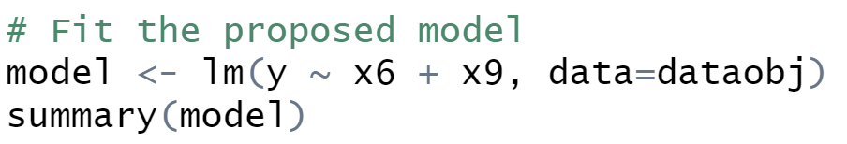
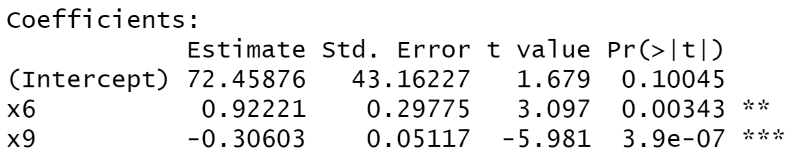
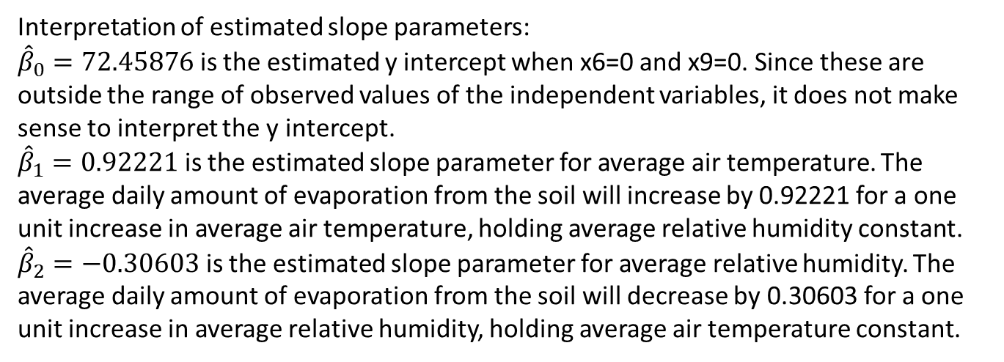
Estimated Multiple Regression Model
Estimated regression models NEVER include a random error term
The estimated regression model is:
$$\hat{y}=72.45876+0.92221x_{6}−0.30603x_{9}$$
Interpretation of estimated slope parameters:
${\hat{β}}_{0}=72.45876$ is the estimated y intercept when x6=0 and x9=0. Since these are outside the range of observed values of the independent variables, it does not make sense to interpret the y intercept.
${\hat{β}}_{1}=0.92221$ is the estimated slope parameter for average air temperature. The average daily amount of evaporation from the soil will increase by 0.92221 for a one unit increase in average air temperature, holding average relative humidity constant.
${\hat{β}}_{2}=−0.30603$ is the estimated slope parameter for average relative humidity. The average daily amount of evaporation from the soil will decrease by 0.30603 for a one unit increase in average relative humidity, holding average air temperature constant.

Slide 8
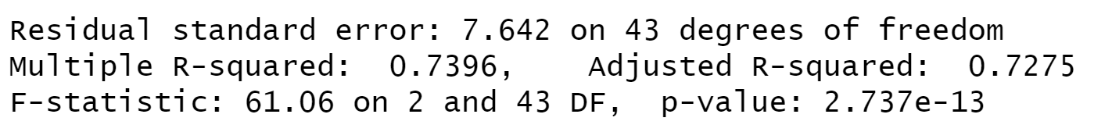
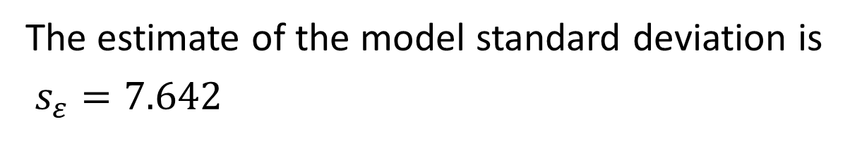
Estimated Model Standard Deviation
The estimate of the model standard deviation is
$s_{ε}=7.642$

Slide 9
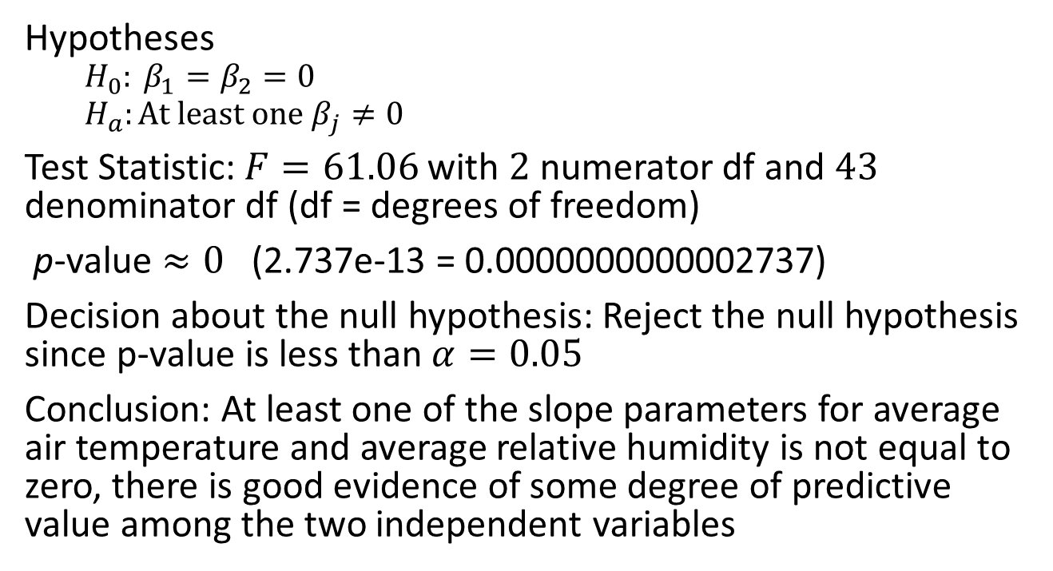
Overall F Test
Hypotheses
$$H_{0}: β_{1}=β_{2}=0$$
$$H_{a}:At least one β_{j}≠0$$
Test Statistic: $F=61.06$ with $2$ numerator df and $43$ denominator df (df = degrees of freedom)
p-value $≈0$ (2.737e-13 = 0.0000000000002737)
Decision about the null hypothesis: Reject the null hypothesis since p-value is less than $α=0.05$
Conclusion: At least one of the slope parameters for average air temperature and average relative humidity is not equal to zero, there is good evidence of some degree of predictive value among the two independent variables

Slide 10

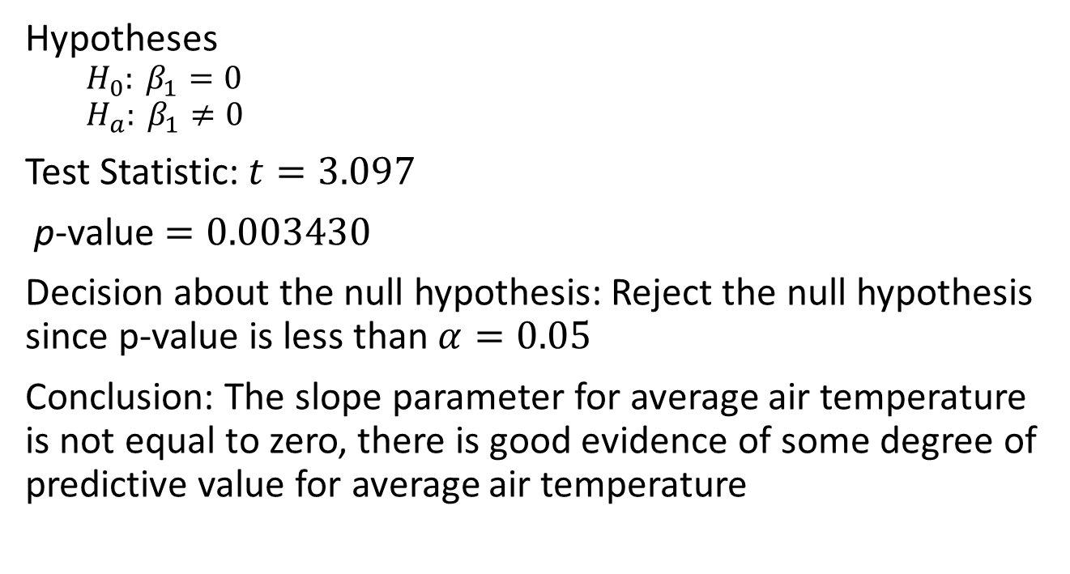
Hypothesis Test for $β_{1}=0$
Hypotheses
$$H_{0}: β_{1}=0$$
$$H_{a}: β_{1}≠0$$
Test Statistic: $t=3.097$
p-value $=0.003430$
Decision about the null hypothesis: Reject the null hypothesis since p-value is less than $α=0.05$
Conclusion: The slope parameter for average air temperature is not equal to zero, there is good evidence of some degree of predictive value for average air temperature

Slide 11

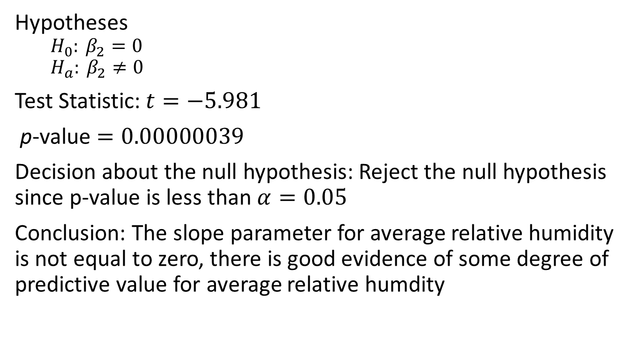
Hypothesis Test for $β_{2}=0$
Hypotheses
$$H_{0}: β_{2}=0$$
$$H_{a}: β_{2}≠0$$
Test Statistic: $t=−5.981$
p-value $=0.00000039$
Decision about the null hypothesis: Reject the null hypothesis since p-value is less than $α=0.05$
Conclusion: The slope parameter for average relative humidity is not equal to zero, there is good evidence of some degree of predictive value for average relative humdity

